Slide 1
Saveo
Final Project Presentation - TalentSprint: Java Full-Stack Development
(Domain: E-commerce)
Siddharth Chatla
Nikhil Reddy
Yamini
Narasimha
Lalith Varma
Jan’2021

Slide 2



Corporate Hospitals (many)
Small Scale Hospitals (many)
Requirement Market (one)
Request form
donors

Slide 3
Problem being solved
This Application provides a market to connect small-scale hospitals to the corporate hospitals to provide them with organs and blood when in need.
There won't be a case of insufficient resources for the rural or underprivileged in medical care.

Slide 4








Technologies used
Spring-Boot
Angular
IntelliJ
VS code
java
TypeScript
HTML
CSS

Slide 5
Dependencies and Imports
Spring Dependencies:
1. Spring Web
2. Spring Data JPA
3. MySQL Driver
Angular Imports:
1. Browser Module
2. App Routing Module
3. Forms Module
4. Router Module
5. Http Client Module
6. Toastr Module

Slide 6
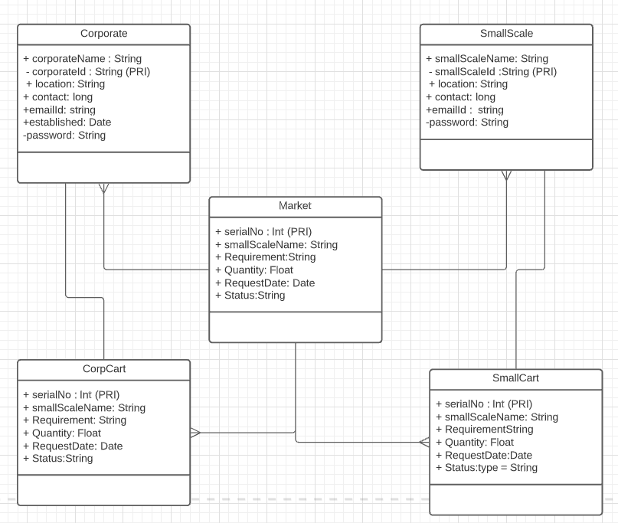
Class Diagram :

Slide 7
Components and process
Spring and Angular Initialization
Login and Register Pages (Forms and Authorization)
Navigation Bar
Request Form (Form)
Market (Table)
Cart (Table)
Payment Gateway (Form)
Source code @ https://github.com/Archenemy-666/TalentSprint/SaveoFinal

Slide 8
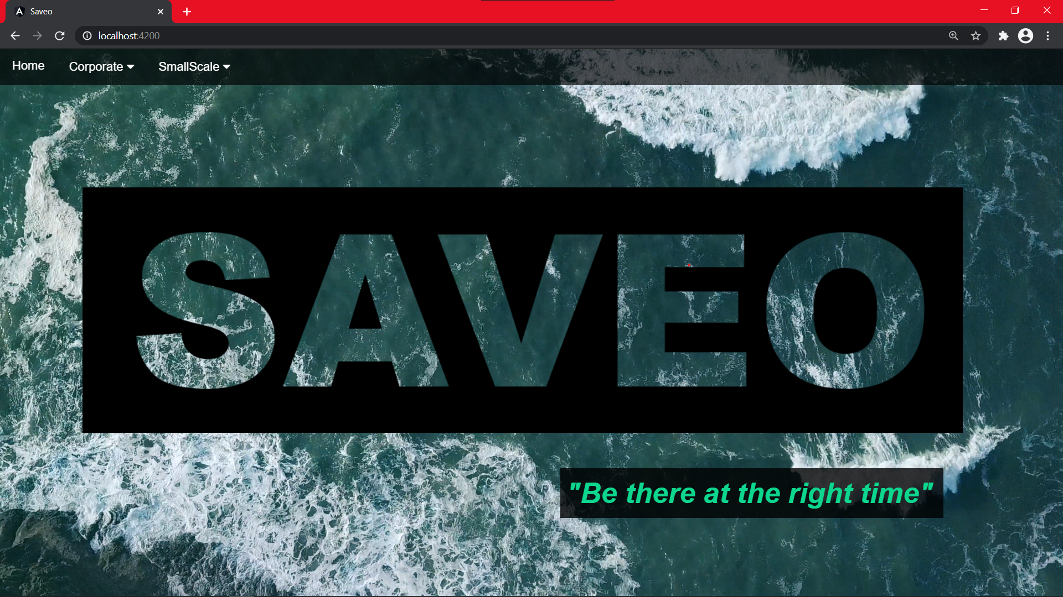

Slide 9
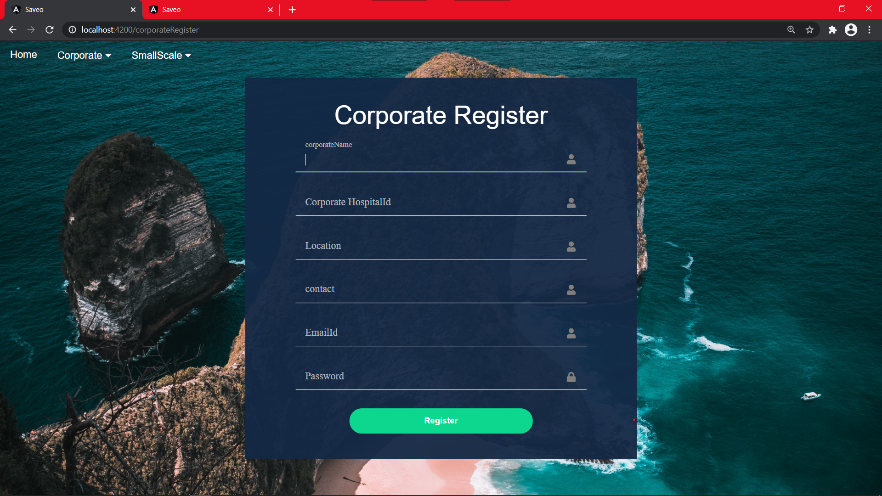

Slide 10
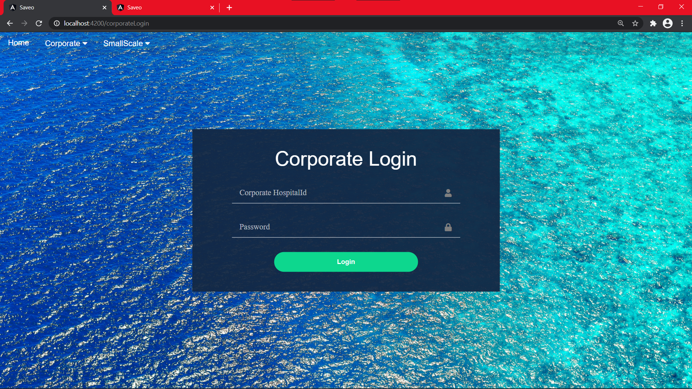

Slide 11
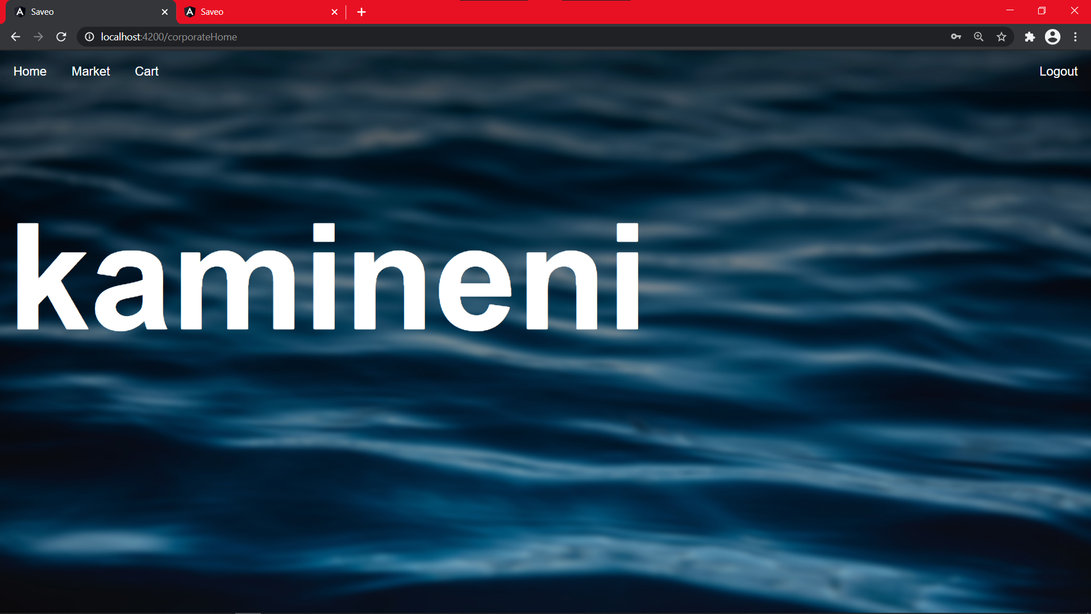

Slide 12
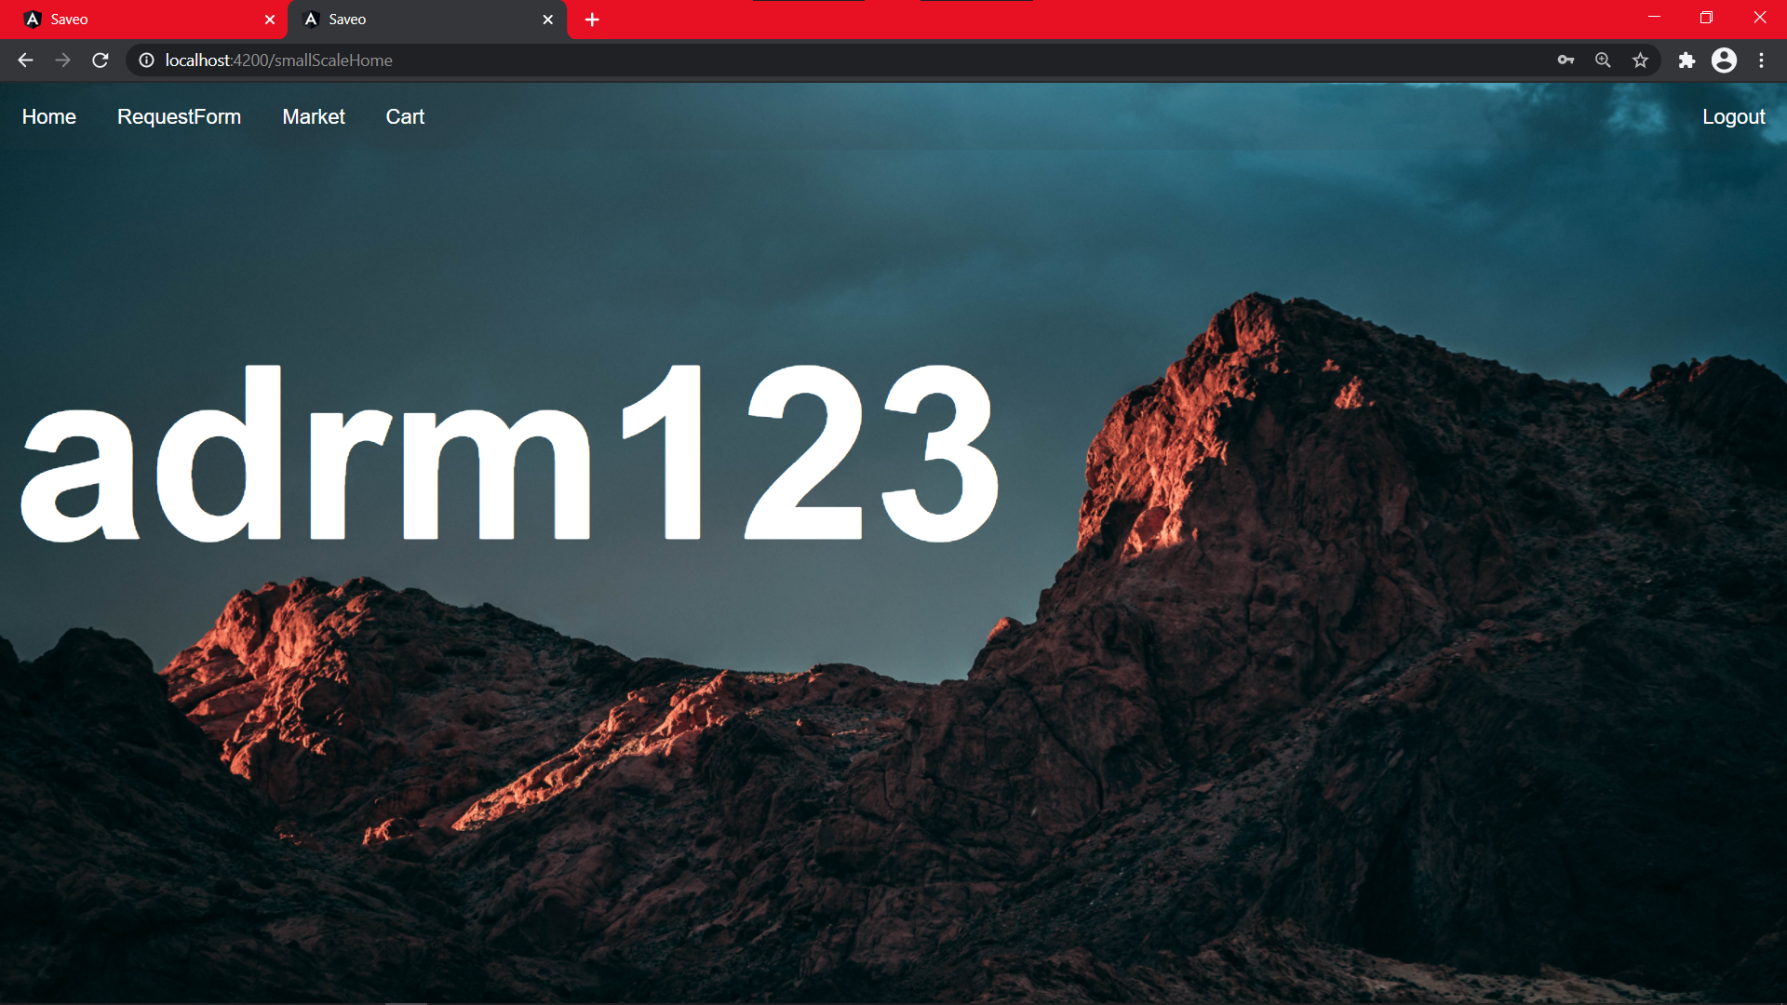

Slide 13
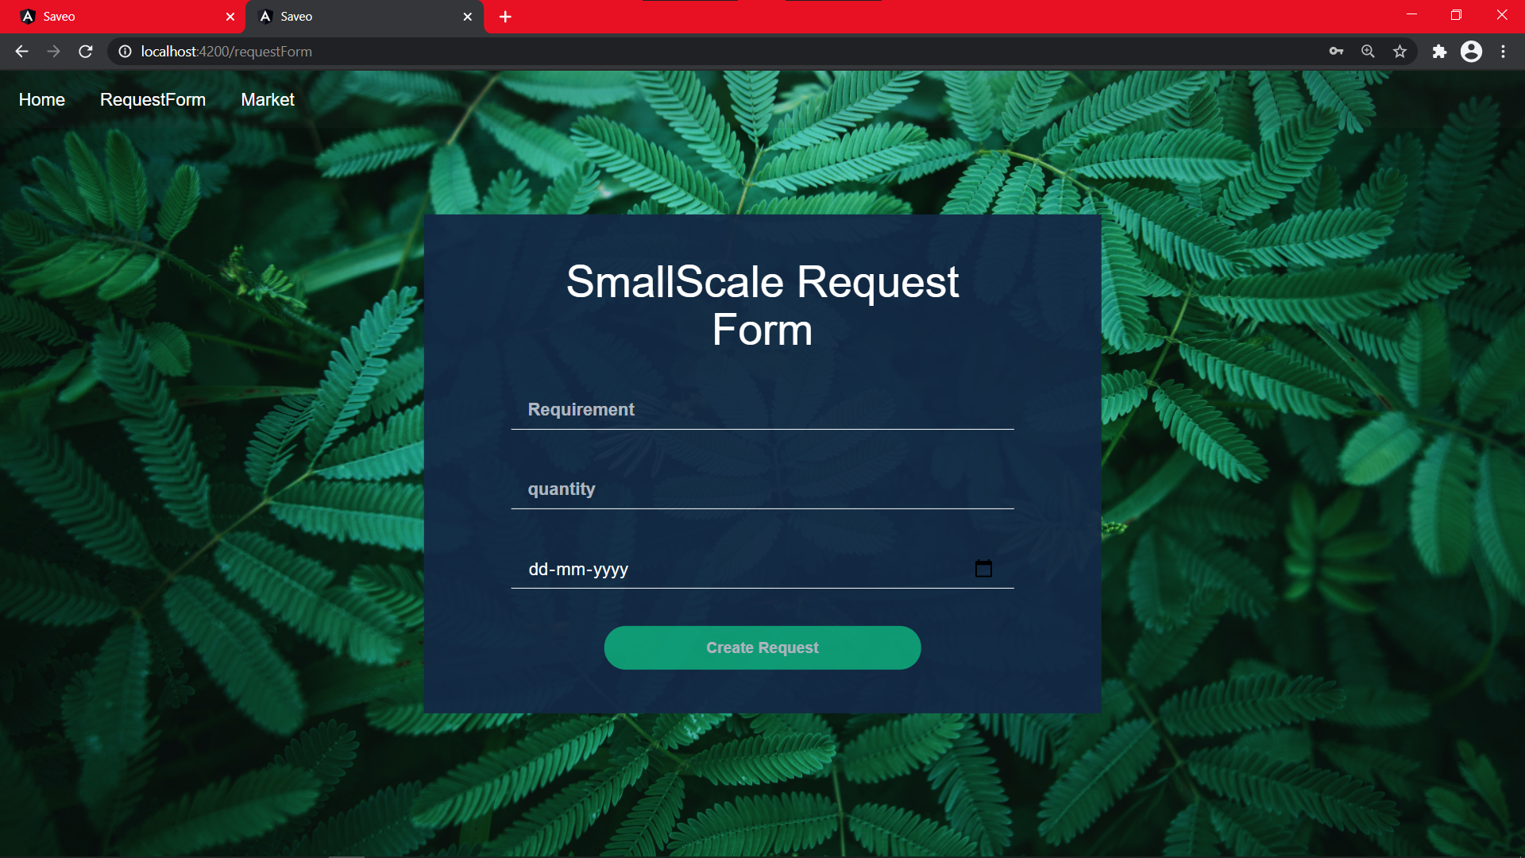

Slide 14
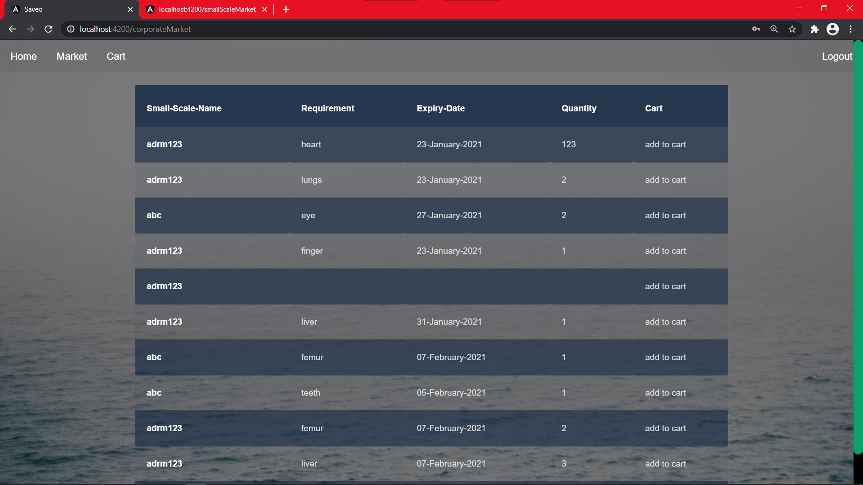

Slide 15
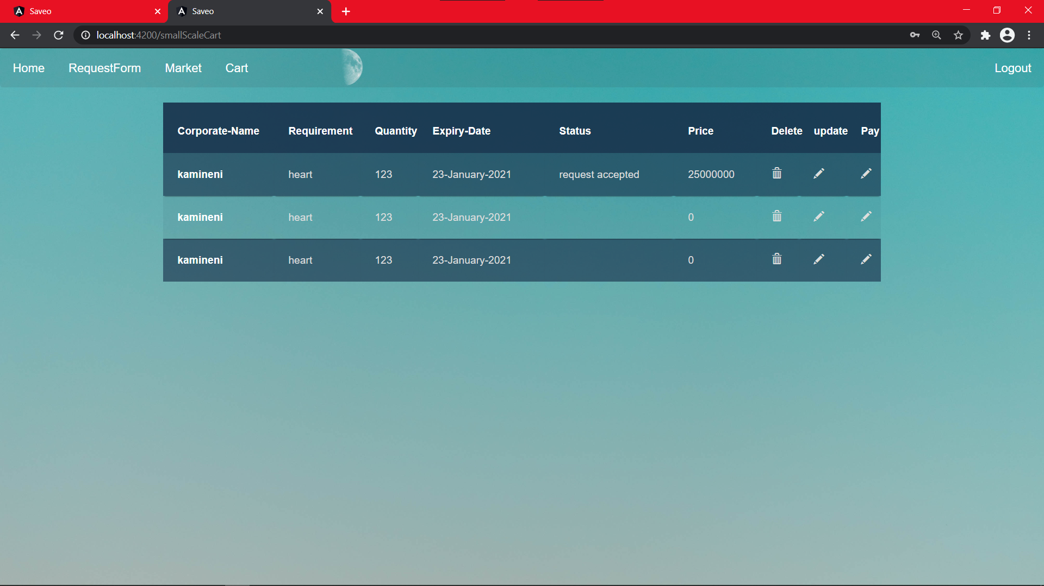

Slide 16
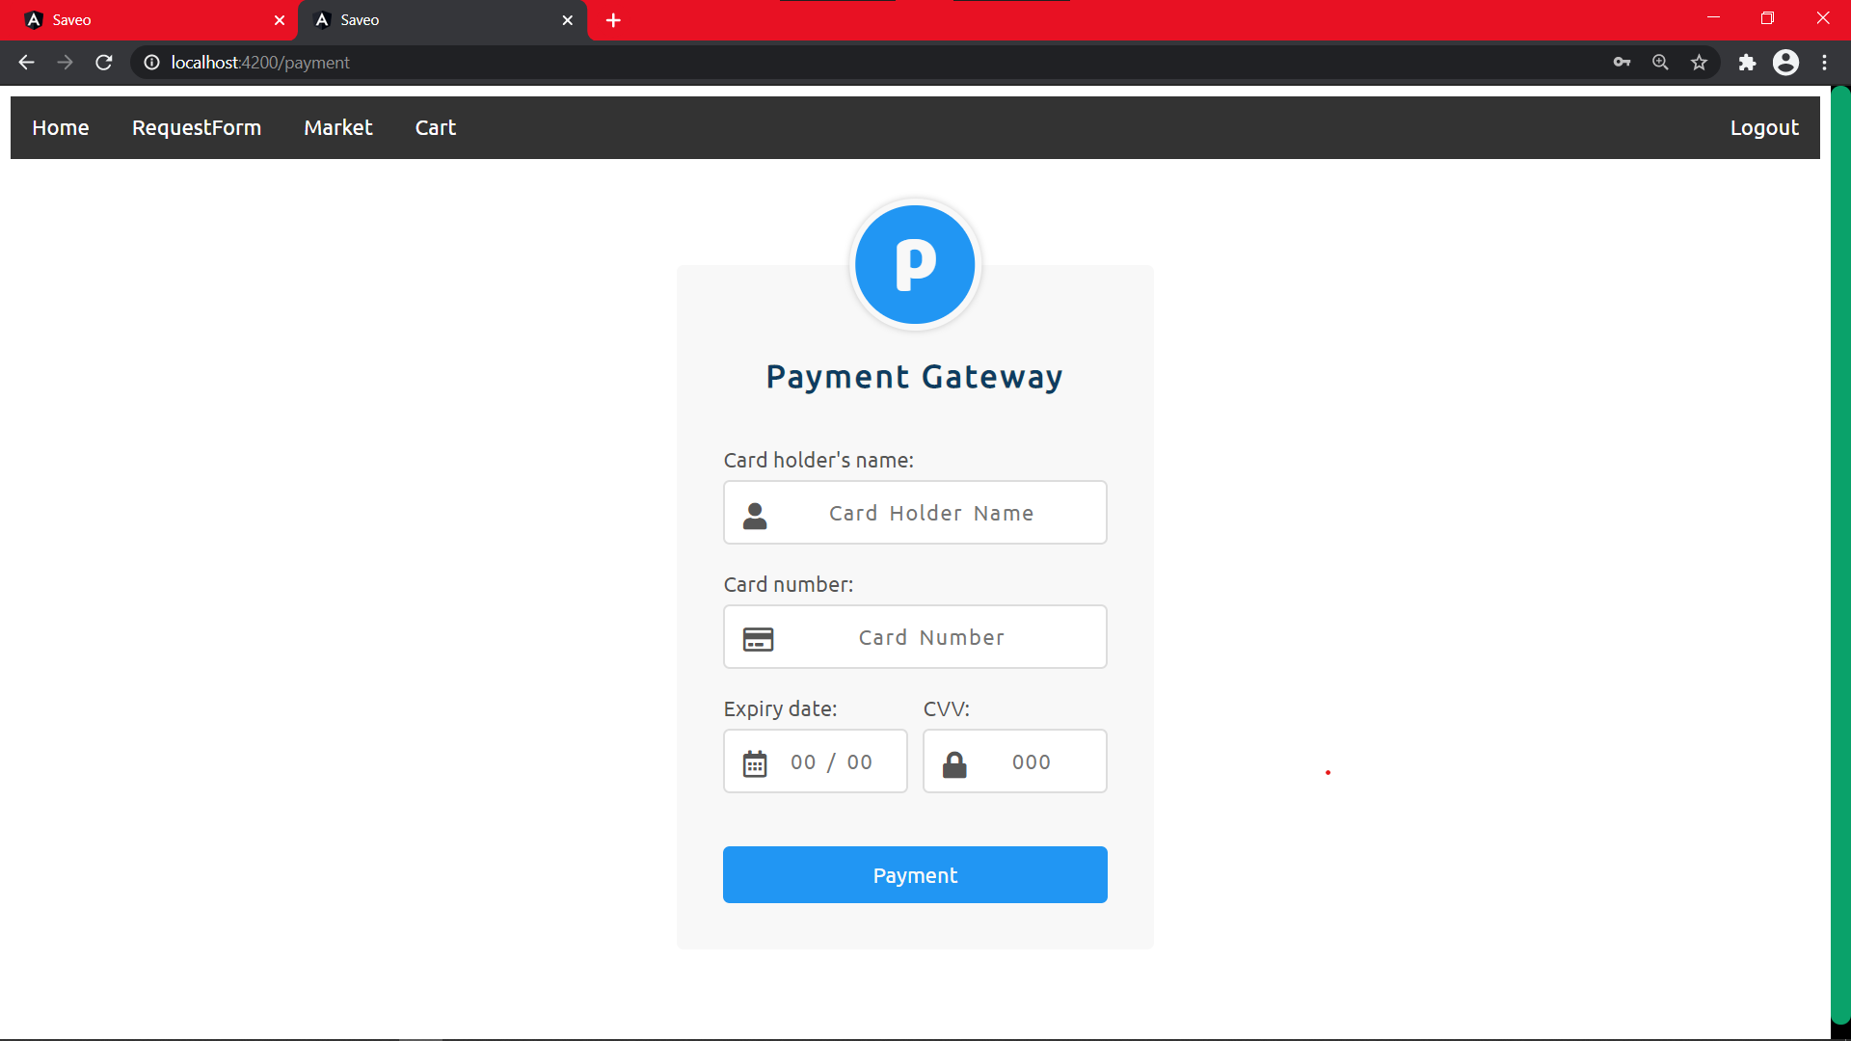

Slide 17
FUTURE DEVELOPMENTS THAT CAN BE MADE
If there is a json page of lists containing small-scale and corporate hospitals then we can authenticate them in a better way during the registration.
A bidding page can be made such that many corporate will bid for the the same requirement and the least price will be accepted by small scale.
The whole payment process can be completed with an interface and this could be binded delivery services provided by the corporate to the Small-Scale Hospital.
There could be a page where a donor’s can also see the requirement and donate the requirement. (only blood).

Slide 18
Problems we faced and how we solved them .

Slide 19
Q & A

Slide 20
Thank You

